Slide 1
Beyond Goldfish Memory: Long-Term Open-Domain Conversation
Jing Xu, Arthur Szlam and Jason Weston
ACL 2022

Slide 2
Multi-Session Conversation
Facebook MSC Dataset
Dataset for long-term conversation, especially in multi-session setting
Take dialog turns(12~14 utterances) in one session, start again after a while
→Similar to daily conversations between humans
Train/Valid/Test, maximum 4/5/5 Sessions
Long-term Conversation with 48~70 utterances in single episode
+Provides summary for the past sessions

Slide 3
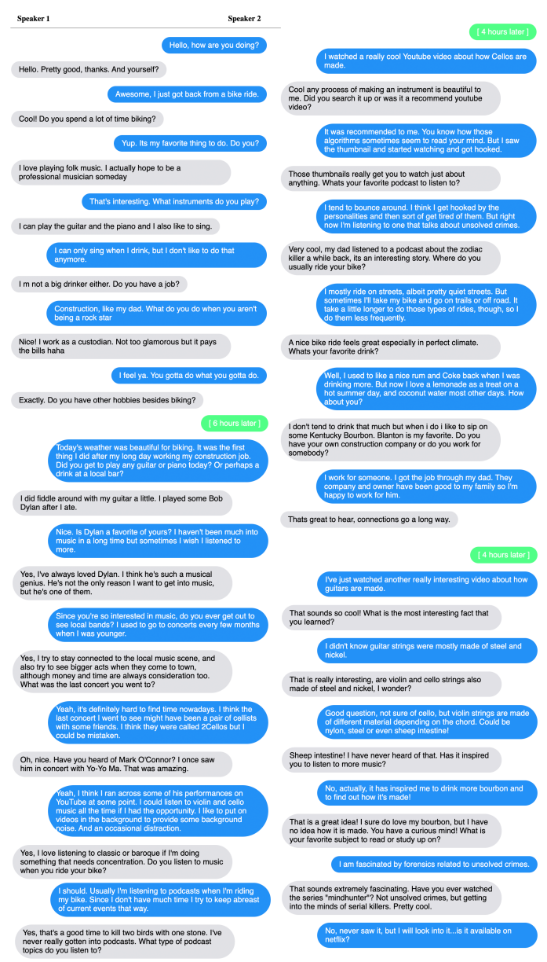

Slide 4
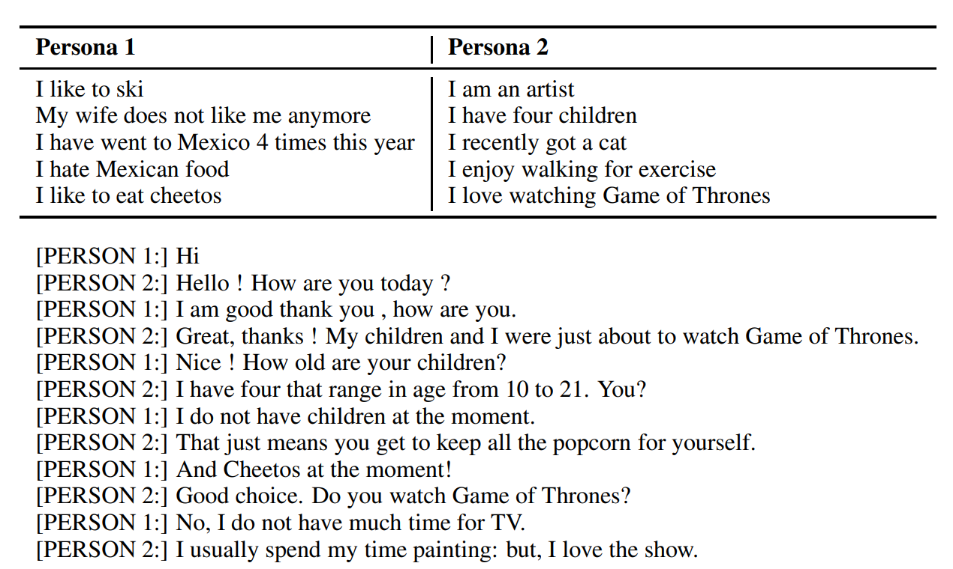
Multi-Session Conversation
Problem to solve
Pretrained LM’s context length limit
→Challenging because utterances should consist Personas that extend while conversations
PersonaChat(Zhang et al., 2018) → Used as Session 1

Slide 5
Baselines
Base model – Blenderbot(BST) 2.7B
Additional Options
1)Retrieval
RAG → neural-retriever-in-the-loop, score top N candidates
FID → Directly choose N documents, encode-decode and generate response.
FID-RAG
2)Memory-Augmented
Summarize the previous contexts, update memories, use for generation

Slide 6
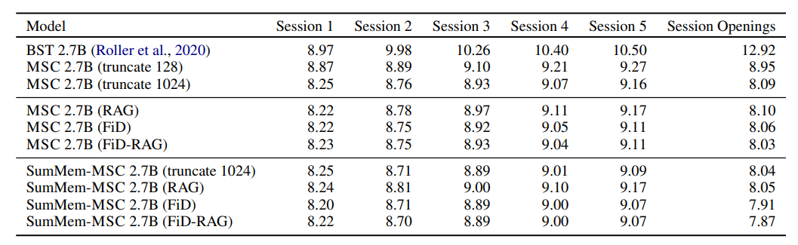
Results
All SumMem-MSC models outperform their retrieval-augmented model counterparts MSC 2.7B (RAG/FiD/FiD-RAG)
Small improvements but beneficial in long-term dialogs

Slide 7
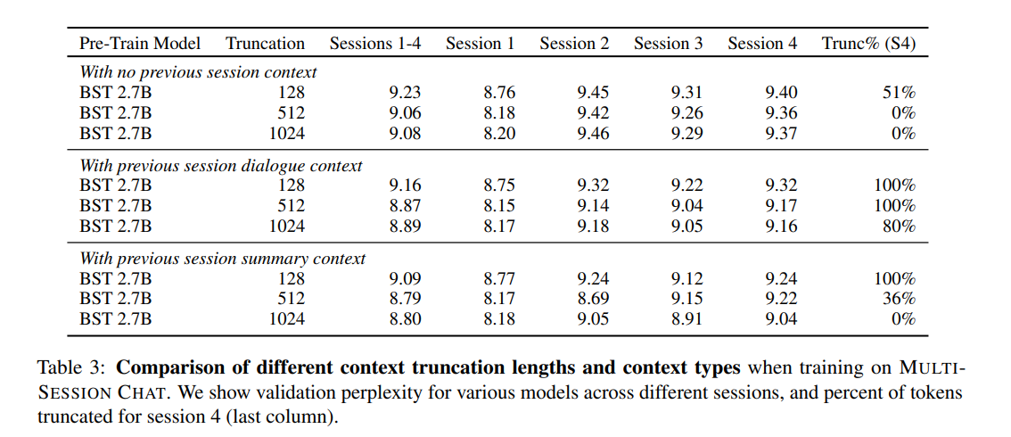
Results
→Using summaries when training gives best results

Slide 8
Latent Modeling for Long-term Dialog System

Slide 9
Goals
For ideal long-term dialog system…
Diverse utterances should be generated
Opponent’s persona detection
Improve in a manner that generates more personalized response

Slide 10
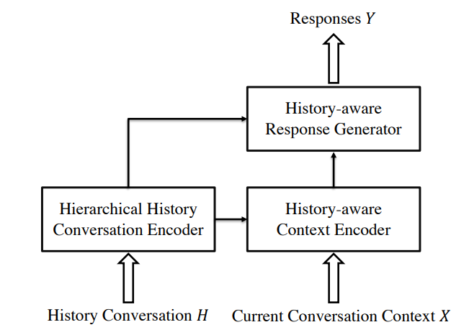
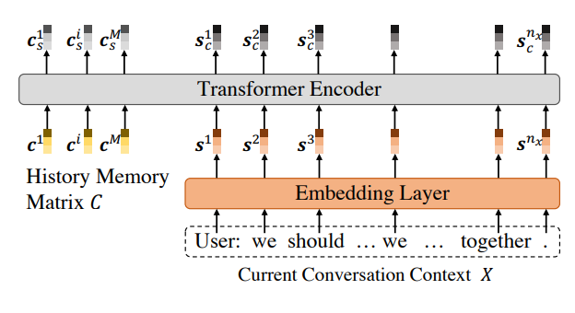
Related Works
History-Aware Hierarchical Transformer for Multi-session Open-domain Dialogue System
Generate history memory for each sessions
Using transformer encoder, read-write the memory

Slide 11
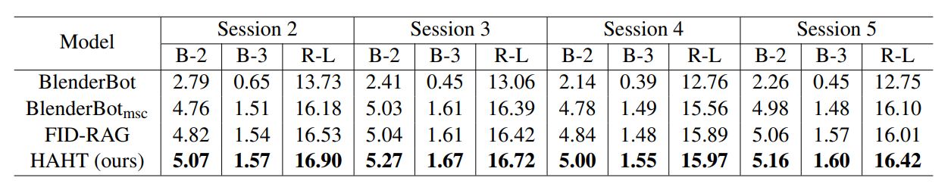
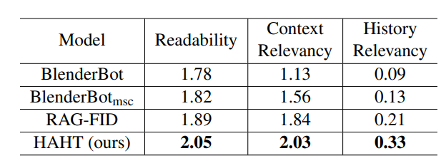
Better than MSC baselines
But no improvement as session number increases
Human Evaluation’s History Relevancy is very low→ Poorly catches history info

Slide 12
Method
Latent Variables for Persona detection, update using contexts & summaries
On-session
$$d=d_{embedding}=d_{latent}$$
$$μ_{d}$$
$$σ_{d}$$
→ $Z_{p}$ (multivariate gaussian)
$${μ′}_{d}$$
$${σ′}_{d}$$
$${μ′}_{d}$$
$${σ′}_{d}$$
Transformer Encoder($q$)
Transformer Encoder($p$)
$$μ_{d}$$
$$σ_{d}$$
$$Context(C)$$
$$target(u)$$
$$μ_{d}$$
$$σ_{d}$$
$$Context(C)$$
$$q_{φ}(Z|Z_{p},C,u)$$
$$p_{θ}(Z|Z_{p},C)$$
$$KL(q||p)$$

Slide 13
Method
On-session
$$d=d_{embedding}=d_{latent}$$
$$target(u)$$
Transformer Decoder($p$)
$${μ′}_{d}$$
$${σ′}_{d}$$
sampling
$$Z$$
+
$$<SOS>$$
$$Context(C)$$
$$E_{q_{φ}(Z|Z_{p},C,u)}[logp_{θ}(u|Z,Z_{p},C)]$$

Slide 14
Method
Inter-session
Update $Z_{p}$ ($Z_{p,n−1}→Z_{p,n}$)
$$Summary_{n}$$
training
Reconstruction loss
$$Z_{p,n−1}, C_{n},$$
$$Summary_{n}$$
Recognition network($q$)
$$μ_{q,n}, σ_{q,n}$$
$$KL(q||p)$$
$$Z_{p,n−1}, C_{n}$$
prior network($p$)
$$μ_{p,n}, σ_{p,n}$$
inference

Slide 15
Experiment Details
Pretrained Model
Dialog generation(On-Session)→GPT-2
Summarization(Inter-Session) → Bart
Using z for
1. S1’s persona
2. S2’s persona
3. Both
Training with Bag-of-words loss

Slide 16
Process
Summarization(Inter-Session)
학습이 되지 않는 상황
Summary 그 자체를 Reconstruct 하도록 학습 목표를 설정했는데, 이 부분을 변경해야 함

Slide 17
Process
Without Summary
Recognization finetuning은 잘 진행됨(test perplexity = 6.16)
그러나 KL loss가 줄어들지 않아 Prior를 사용하기 어려움.

Slide 18
Process
모델 작동 방식 변경

Slide 19


Method
Inter-session
Update $Z_{p}$ ($Z_{p,n−1}→Z_{p,n}$)
training
$$Summary_{n}$$
Recognition network($q$)
$$μ_{q,n}, σ_{q,n}$$
$$Z_{p,n−1}, C_{n}$$
prior network($p$)
$$μ_{p,n}, σ_{p,n}$$
inference

Slide 20


Method
On-session
$$d=d_{embedding}=d_{latent}$$
$$target(u)$$
Transformer Decoder($p$)
$$μ_{d}$$
$$σ_{d}$$
sampling
$$Z$$
+
$$<SOS>$$
$$Context(C)$$

Slide 21
Experiment result
 | GPT-2(BOW) | DialoGPT(BOW)
BLEU-1 | 7.26 | 7.04
BLEU-2 | 1.47 | 1.73
BLEU-3 | 0.40 | 0.54
BLEU-4 | 0.10 | 0.13
Using BOW → No big difference
DialoGPT > GPT-2
-Need to strengthen the effect of latent variables
-Use DialoGPT for further experiments

Slide 22
Initial Distribution = N(0, 1)
계속 0으로 유지되어 효과를 주지 못할 가능성

Slide 23
Contributions
Method based on thought that speaker's persona can be represented as latent distribution, and its precision improves while conversation goes on
2. Solving long term multi session conversation problem using single distribution memory without any other additional memories
3. make model learn how to use summarized information to improve precision of latent distribution

Slide 24
05/04
데이터 전처리 과정에서 오류를 발견, 수정
→DialoGPT FineTuning 결과

Slide 25
05/11
 | Session2 |  |  | Session3 |  |  | Session4 |  |  | Session5
 | B-2 | B-3 | R-L | B-2 | B-3 | R-L | B-2 | B-3 | R-L | B-2 | B-3 | R-L
Base | 4.25 | 2.30 | 15.24 | 4.01 | 2.06 | 15.28 | 3.75 | 1.91 | 14.84 | 4.05 | 2.02 | 15.36
w/o BOW | 4.48 | 2.57 | 15.48 | 4.19 | 2.37 | 15.16 | 3.90 | 2.17 | 14.79 | 4.17 | 2.30 | 15.43
BOW | 4.52 | 2.59 | 15.49 | 4.19 | 2.38 | 15.20 | 3.84 | 2.11 | 14.90 | 4.07 | 2.23 | 15.26
DialoGPT MSC Finetuning
+Latent Variable
+BOW

Slide 26
Generation 도중 Latent Distribution을 출력해 확인→값이 0에 몰려 있지는 않았음
현재 모델은 Latent Variable과 Embedding의 vector length가 동일, 바로 더하는 방식
→Latent Variable 차원을 늘리고 Dense Layer에 넣어 그 결과물을 Embedding에 더해보기

Slide 27
05/18
Transformer Encoder → GPT-2
Latent Variable Dimension Increase
두 경우 모두 큰 효과가 없음
 | Session2 |  |  | Session3 |  |  | Session4 |  |  | Session5
 | B-2 | B-3 | R-L | B-2 | B-3 | R-L | B-2 | B-3 | R-L | B-2 | B-3 | R-L
Base | 4.25 | 2.30 | 15.24 | 4.01 | 2.06 | 15.28 | 3.75 | 1.91 | 14.84 | 4.05 | 2.02 | 15.36
w/o BOW | 4.48 | 2.57 | 15.48 | 4.19 | 2.37 | 15.16 | 3.90 | 2.17 | 14.79 | 4.17 | 2.30 | 15.43
BOW | 4.52 | 2.59 | 15.49 | 4.19 | 2.38 | 15.20 | 3.84 | 2.11 | 14.90 | 4.07 | 2.23 | 15.26
GPT Enc | 4.30 | 2.48 | 15.23 | 4.08 | 2.27 | 15.01 | 3.81 | 2.13 | 14.66 | 4.09 | 2.25 | 15.33
V_inc | 4.23 | 2.45 | 15.16 | 4.05 | 2.28 | 14.80 | 3.76 | 2.10 | 14.51 | 3.91 | 2.17 | 15.01

Slide 28
문제점
-Batch size 에 따른 학습 결과의 차이가 있음
-Generation metho에 따른 metrics 차이가 큼, baseline의 generation method가 논문에 나와있지 않음
→특히 Distinct-1/2 등을 측정할 때 no_repeat_ngram_size 세팅이 큰 영향을 줄 것
Baseline과의 올바른 비교를 위해 Blenderbot으로 base model 변경, 코드 작성 완료
학습 결과 이전 GPT를 사용할 때와 같이 이상한 답변만 생성되는 문제 해결 중

Slide 29
05/25
Blenderbot 생성 결과
→당연한, 같은 말만 계속 반복.
Ex) "that's great! i'm so happy for you. + <question>”
의 형태
BLEU, ROUGE 모두 DialoGPT 모델보다 현저히 낮음
Batch size 32보다 8이 validation loss 자체는 더 나음, DialoGPT도 동일

Slide 30
Latent dimension →256 (decrease)
Residual
Latent Dist = ?
➔
Latent Dist = Latent Dist + ?
 | Session2 |  |  | Session3 |  |  | Session4 |  |  | Session5
 | B-2 | B-3 | R-L | B-2 | B-3 | R-L | B-2 | B-3 | R-L | B-2 | B-3 | R-L
Base | 4.25 | 2.30 | 15.24 | 4.01 | 2.06 | 15.28 | 3.75 | 1.91 | 14.84 | 4.05 | 2.02 | 15.36
w/o BOW | 4.48 | 2.57 | 15.48 | 4.19 | 2.37 | 15.16 | 3.90 | 2.17 | 14.79 | 4.17 | 2.30 | 15.43
BOW | 4.52 | 2.59 | 15.49 | 4.19 | 2.38 | 15.20 | 3.84 | 2.11 | 14.90 | 4.07 | 2.23 | 15.26
GPT Enc | 4.30 | 2.48 | 15.23 | 4.08 | 2.27 | 15.01 | 3.81 | 2.13 | 14.66 | 4.09 | 2.25 | 15.33
Res | 4.36 | 2.54 | 15.16 | 4.07 | 2.27 | 15.07 | 3.75 | 2.07 | 14.73 | 4.01 | 2.21 | 15.27
V_inc | 4.23 | 2.45 | 15.16 | 4.05 | 2.28 | 14.80 | 3.76 | 2.10 | 14.51 | 3.91 | 2.17 | 15.01
V_dec | 4.50 | 2.58 | 15.33 | 4.18 | 2.36 | 15.19 | 3.83 | 2.11 | 14.81 | 4.13 | 2.27 | 15.39

Slide 31
06/01
Batchsize 16
Batchsize 8
 | Session2 |  |  | Session3 |  |  | Session4 |  |  | Session5
 | B-2 | B-3 | R-L | B-2 | B-3 | R-L | B-2 | B-3 | R-L | B-2 | B-3 | R-L
Dist_base | 4.70 | 2.71 | 15.69 | 4.41 | 2.48 | 15.44 | 4.09 | 2.26 | 15.08 | 4.31 | 2.35 | 15.72
Sep_V256 | 4.63 | 2.65 | 15.63 | 4.44 | 2.51 | 15.42 | 4.11 | 2.29 | 15.20 | 4.29 | 2.33 | 15.74
 | Session2 |  |  | Session3 |  |  | Session4 |  |  | Session5
 | B-2 | B-3 | R-L | B-2 | B-3 | R-L | B-2 | B-3 | R-L | B-2 | B-3 | R-L
Dist_base | 4.63 | 2.66 | 15.62 | 4.36 | 2.48 | 15.29 | 4.08 | 2.25 | 15.08 | 4.36 | 2.39 | 15.74
Sep_summ | 4.58 | 2.63 | 15.57 | 4.43 | 2.50 | 15.42 | 4.13 | 2.25 | 15.09 | 4.34 | 2.38 | 15.84

Slide 32
session: 1 BLEUs: 0.1025363059013393 0.04179897891227226 0.02517323759543412 0.01869265435112738 0.13007502012895902
session: 2 BLEUs: 0.11717478350187985 0.04294844479185419 0.022761537968297496 0.015189499815174848 0.15244757940543016
session: 3 BLEUs: 0.11376829671240746 0.04007238159471984 0.02061591488477094 0.013744627214556967 0.15048970074537202
session: 4 BLEUs: 0.11508170580640392 0.03943832359058132 0.01964450037253508 0.012944275427889621 0.15069786634531881
session: 5 BLEUs: 0.1188018917893124 0.0417803229790866 0.020752869996940298 0.013335134462337389 0.1554431597998545
 | Session2 |  |  | Session3 |  |  | Session4 |  |  | Session5
 | B-2 | B-3 | R-L | B-2 | B-3 | R-L | B-2 | B-3 | R-L | B-2 | B-3 | R-L
Dist_base | 4.70 | 2.71 | 15.69 | 4.41 | 2.48 | 15.44 | 4.09 | 2.26 | 15.08 | 4.31 | 2.35 | 15.72
Sep_V256 | 4.63 | 2.65 | 15.63 | 4.44 | 2.51 | 15.42 | 4.11 | 2.29 | 15.20 | 4.29 | 2.33 | 15.74

Slide 33
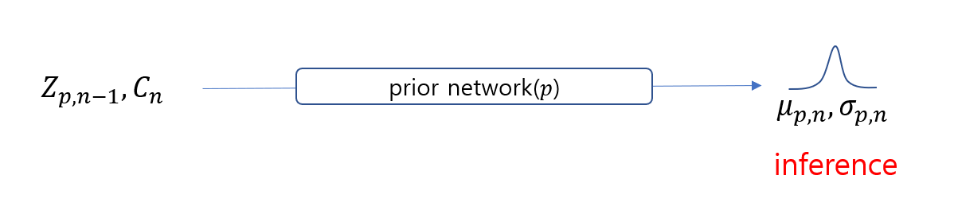

06/07
Prior network에서 $C_{n}$Encoding(Transformer)후 $Z_{p,n−1}$와 함께 GRU로 처리 → $Z_{p,n}$
Base | 4.25 | 2.30 | 15.24 | 4.01 | 2.06 | 15.28 | 3.75 | 1.91 | 14.84 | 4.05 | 2.02 | 15.36
 | Session2 |  |  | Session3 |  |  | Session4 |  |  | Session5
 | B-2 | B-3 | R-L | B-2 | B-3 | R-L | B-2 | B-3 | R-L | B-2 | B-3 | R-L
Dist | 4.70 | 2.71 | 15.69 | 4.41 | 2.48 | 15.44 | 4.09 | 2.26 | 15.08 | 4.31 | 2.35 | 15.72
V256 | 4.63 | 2.65 | 15.63 | 4.44 | 2.51 | 15.42 | 4.11 | 2.29 | 15.20 | 4.29 | 2.33 | 15.74
V256_GRU | 4.48 | 2.58 | 15.35 | 4.26 | 2.40 | 15.28 | 3.91 | 2.15 | 14.97 | 4.16 | 2.29 | 15.51
Single vector
Dual vector

Slide 34
Generation 방식에 대한 실험
BLEU, ROUGE 등 auto metrics는 beam search가 sampling(top p, top k)보다 월등히 좋음
num_beams 1~10까지 실험, 5 이상부터는 성능상 큰 차이는 없음

Slide 35
6/14
Base | 4.65 | 2.66 | 15.61 | 4.34 | 2.44 | 15.41 | 4.03 | 2.23 | 15.12 | 4.23 | 2.31 | 15.55
 | Session2 |  |  | Session3 |  |  | Session4 |  |  | Session5
 | B-2 | B-3 | R-L | B-2 | B-3 | R-L | B-2 | B-3 | R-L | B-2 | B-3 | R-L
Dist | 4.70 | 2.71 | 15.69 | 4.41 | 2.48 | 15.44 | 4.09 | 2.26 | 15.08 | 4.31 | 2.35 | 15.72
V256 | 4.63 | 2.65 | 15.63 | 4.44 | 2.51 | 15.42 | 4.11 | 2.29 | 15.20 | 4.29 | 2.33 | 15.74
V256_GRU | 4.48 | 2.58 | 15.35 | 4.26 | 2.40 | 15.28 | 3.91 | 2.15 | 14.97 | 4.16 | 2.29 | 15.51
Single vector
Dual vector

